Slide 1
9. Unit Roots
ECFI 2019-20
Class 25 March – April 1 2020

Slide 2
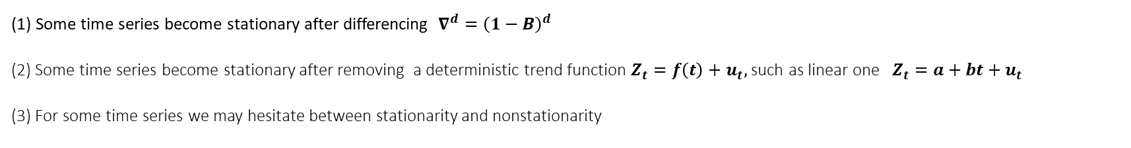
9.1. Stationarity, stochastic and deterministic trends
(1) Some time series become stationary after differencing $∇^{d}={\left(1−B\right)}^{d}$
(2) Some time series become stationary after removing a deterministic trend function $Z_{t}=f\left(t\right)+u_{t},$ such as linear one $Z_{t}=a+bt+u_{t}$
(3) For some time series we may hesitate between stationarity and nonstationarity
Case (1)
ww04.dat : US women unemployment
ww04.dat : US women unemployment change

Slide 3
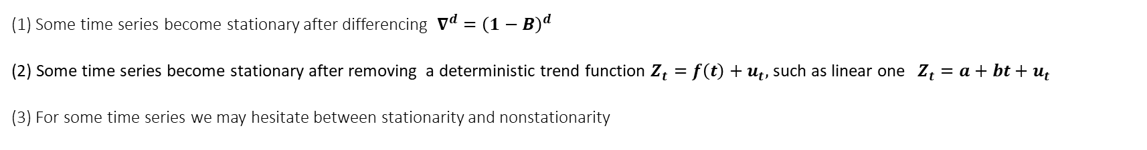
(1) Some time series become stationary after differencing $∇^{d}={\left(1−B\right)}^{d}$
(2) Some time series become stationary after removing a deterministic trend function $Z_{t}=f\left(t\right)+u_{t},$ such as linear one $Z_{t}=a+bt+u_{t}$
(3) For some time series we may hesitate between stationarity and nonstationarity
Case (2)

Slide 4
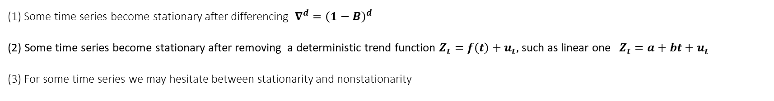
(1) Some time series become stationary after differencing $∇^{d}={\left(1−B\right)}^{d}$
(2) Some time series become stationary after removing a deterministic trend function $Z_{t}=f\left(t\right)+u_{t},$ such as linear one $Z_{t}=a+bt+u_{t}$
(3) For some time series we may hesitate between stationarity and nonstationarity
Case (1) or (2) ?
US Log Population
Differences
Trend residuals

Slide 5
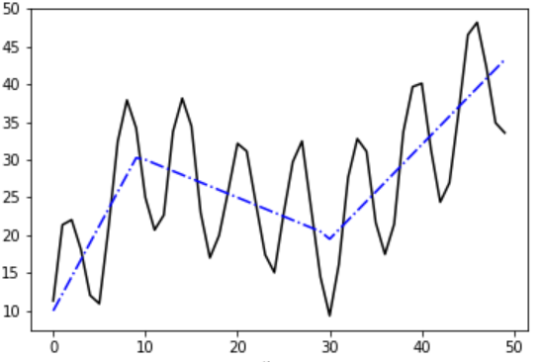
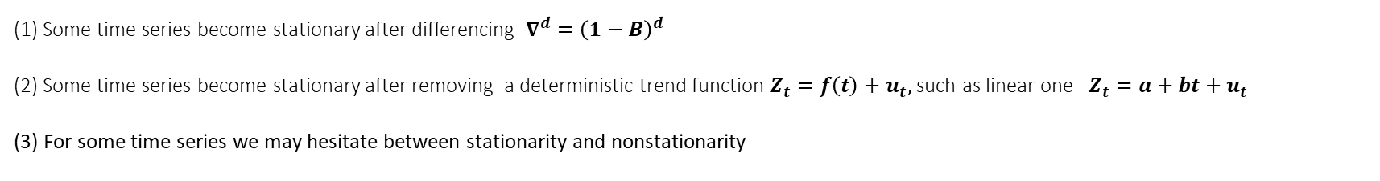
(1) Some time series become stationary after differencing $∇^{d}={\left(1−B\right)}^{d}$
(2) Some time series become stationary after removing a deterministic trend function $Z_{t}=f\left(t\right)+u_{t},$ such as linear one $Z_{t}=a+bt+u_{t}$
(3) For some time series we may hesitate between stationarity and nonstationarity
Case (3)

Slide 6
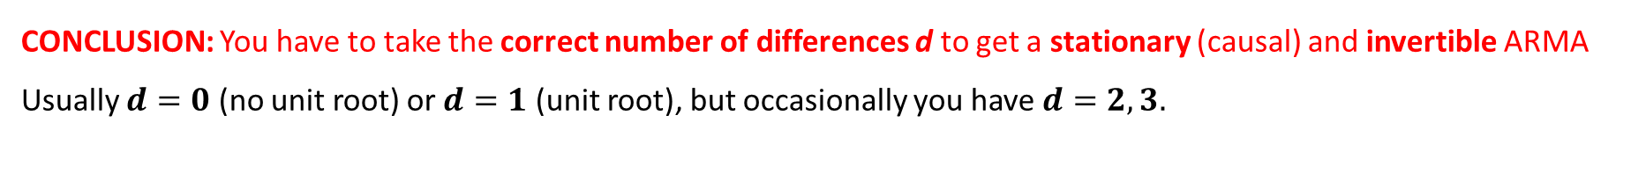

Take the right differences, if you should…
Assume $Z_{t}$ is an ARIMA(p,1,q) → $Z_{t}$ is under-differenced → nonstationary + invertible
$$φ\left(B\right)\left(1−B\right)Z_{t}=θ\left(B\right)a_{t}$$
$$φ^{∗}\left(B\right)Z_{t}=θ\left(B\right)a_{t}$$
$φ^{∗}\left(B\right)$ has a unit root
Now, assume $X_{t}$ is an ARMA(p,q) → and we difference it: $Z_{t}=∇X_{t}$ is over-differenced → stationary + noninvertible
$$φ\left(B\right)Z_{t}=\left(1−B\right)θ\left(B\right)a_{t}$$
$$φ\left(B\right)Z_{t}=θ^{∗}\left(B\right)a_{t}$$
$θ^{∗}\left(B\right)$ has a unit root
CONCLUSION: You have to take the correct number of differences d to get a stationary (causal) and invertible ARMA
Usually $d=0$ (no unit root) or $d=1$ (unit root), but occasionally you have $d=2, 3.$

Slide 7
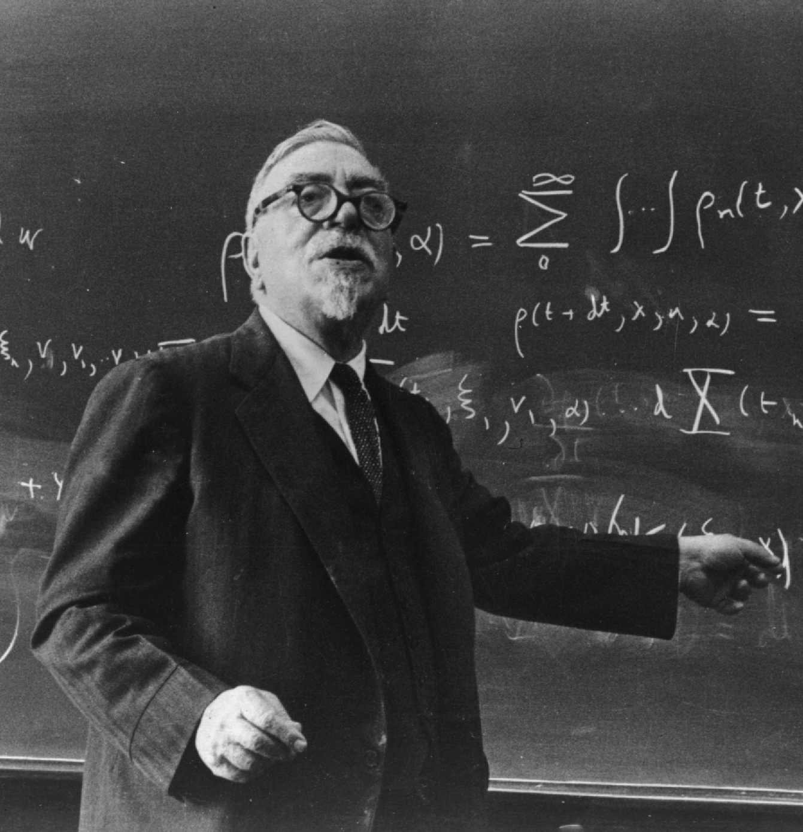
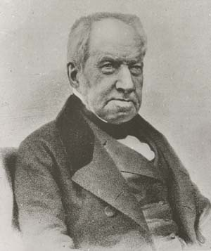
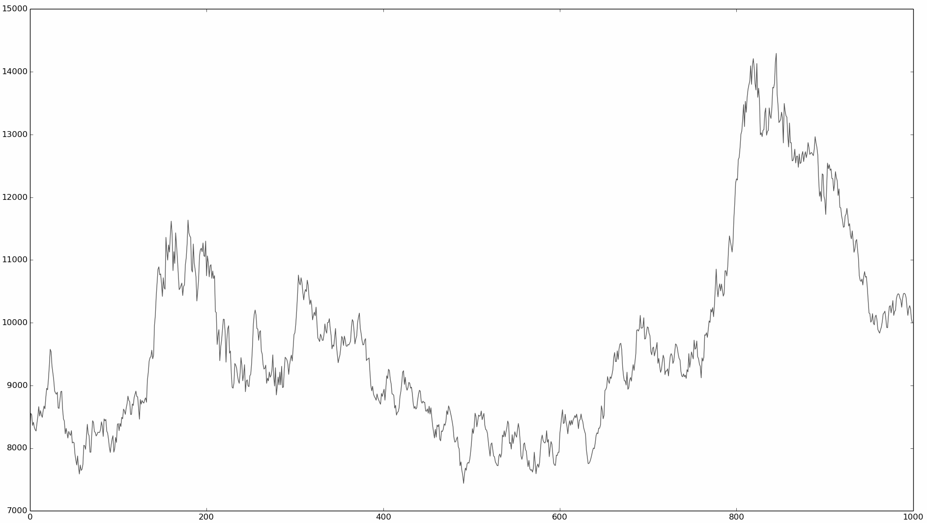
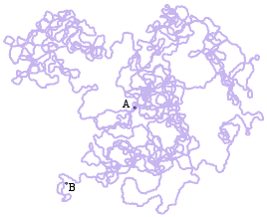
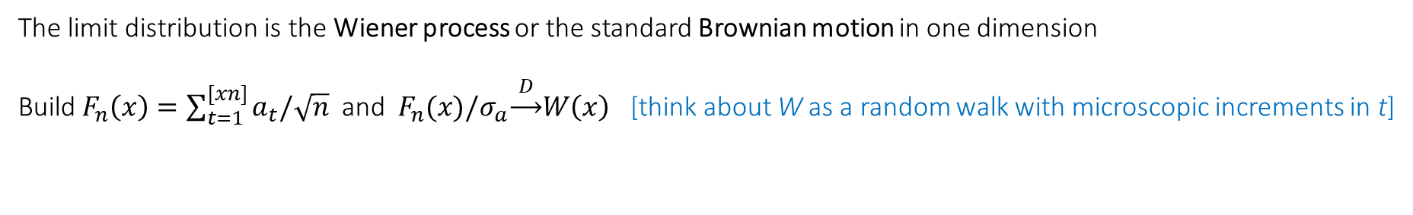
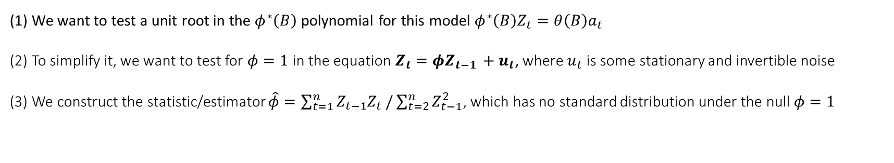
9.2. Limit distributions for UR testing
(1) We want to test a unit root in the $φ^{∗}\left(B\right)$ polynomial for this model $φ^{∗}\left(B\right)Z_{t}=θ\left(B\right)a_{t}$
(2) To simplify it, we want to test for $φ=1$ in the equation $Z_{t}=φZ_{t−1 }+u_{t}$, where $u_{t}$ is some stationary and invertible noise
(3) We construct the statistic/estimator $\hat{φ}=\sum_{t=1}^{n}{Z_{t−1}Z_{t}}/\sum_{t=2}^{n}{Z_{t−1}^{2}}$, which has no standard distribution under the null $φ=1$
The limit distribution is the Wiener process or the standard Brownian motion in one dimension
Build $F_{n}\left(x\right)=\sum_{t=1}^{[xn]}{a_{t}/\sqrt{n}}$ and $F_{n}(x)/σ_{a}\underset{→}{ D }W\left(x\right)$ [think about W as a random walk with microscopic increments in t]

Slide 8
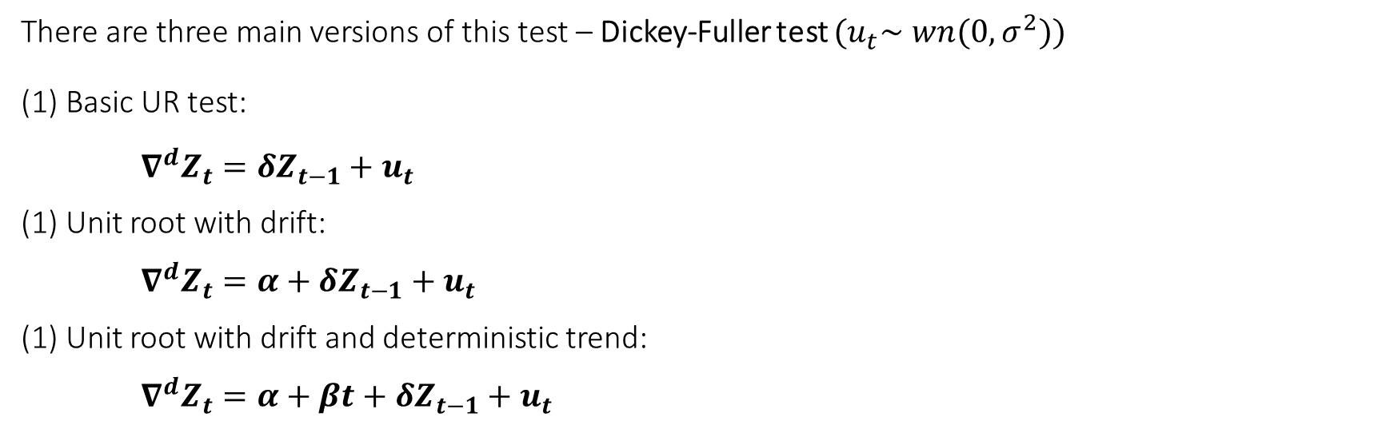
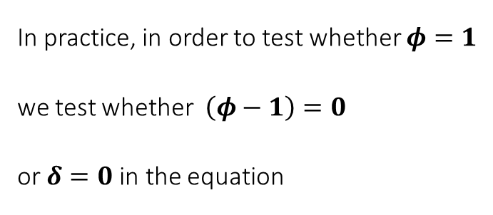
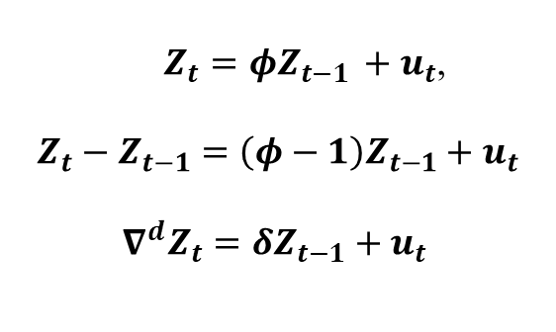
9.3. Three UR tests
In practice, in order to test whether $φ=1$
we test whether $\left(φ−1\right)=0$
or $δ=0$in the equation
$Z_{t}=φZ_{t−1 }+u_{t}$,
$$Z_{t}−Z_{t−1}=\left(φ−1\right)Z_{t−1}+u_{t}$$
$∇^{d}Z_{t}=δZ_{t−1}+u_{t}$
There are three main versions of this test – Dickey-Fuller test ${(u}_{t}∼wn(0,σ^{2}))$
Basic UR test:
$∇^{d}Z_{t}=δZ_{t−1}+u_{t}$
Unit root with drift:
$∇^{d}Z_{t}=α+δZ_{t−1}+u_{t}$
Unit root with drift and deterministic trend:
$∇^{d}Z_{t}=α+βt+δZ_{t−1}+u_{t}$

Slide 9

The test framework:
$$\left\{\begin{aligned}H_{0}:τ=0 \\ H_{1}:τ<0 \end{aligned}\right.$$
Rejection region

Slide 10
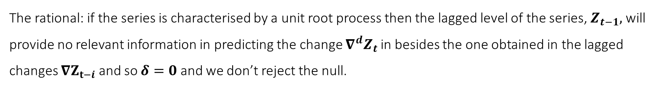
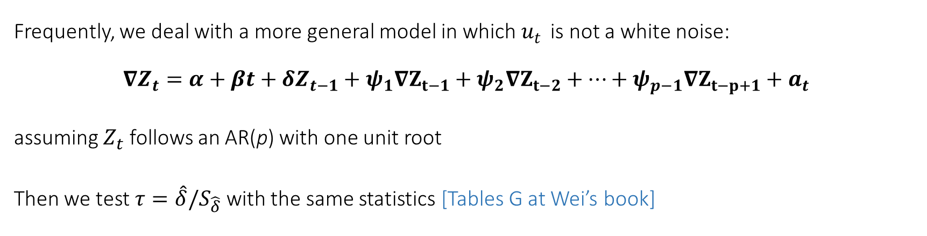
9.4. Augmented Dickey Fuller (ADF) tests
Frequently, we deal with a more general model in which $u_{t }$is not a white noise:
$$∇Z_{t}=α+βt+δZ_{t−1}+ψ_{1}∇Z_{t−1}+ψ_{2}∇Z_{t−2}+…+ψ_{p−1}∇Z_{t−p+1}+a_{t}$$
assuming $Z_{t}$ follows an AR(p) with one unit root
Then we test $τ=\hat{δ}/S_{\hat{δ}}$ with the same statistics [Tables G at Wei’s book]
The rational: if the series is characterised by a unit root process then the lagged level of the series, $Z_{t−1},$ will provide no relevant information in predicting the change $∇^{d}Z_{t}$ in besides the one obtained in the lagged changes $∇Z_{t−i}$ and so $δ=0$ and we don’t reject the null.

Slide 11
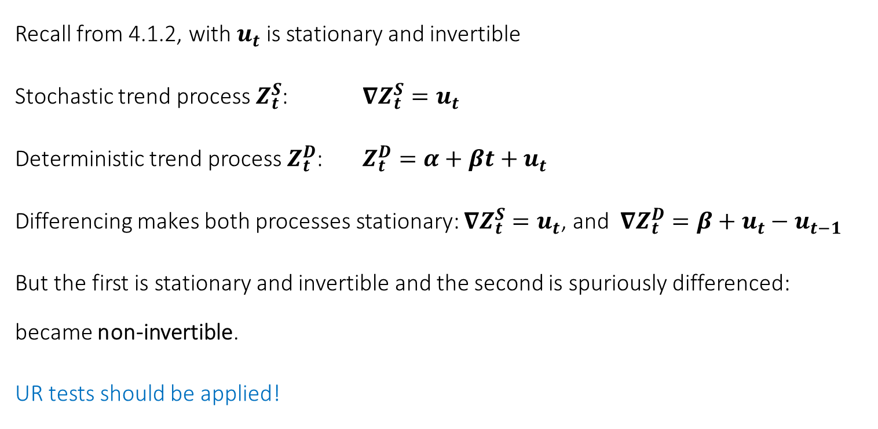
Stochastic trends (UR) vs deterministic trends
Recall from 4.1.2, with $u_{t}$ is stationary and invertible
Stochastic trend process $Z_{t}^{S}$: $∇Z_{t}^{S}=u_{t}$
Deterministic trend process $Z_{t}^{D}$: $Z_{t}^{D}=α+βt+u_{t}$
Differencing makes both processes stationary: $∇Z_{t}^{S}=u_{t}$, and ${∇Z}_{t}^{D}=β+u_{t}−u_{t−1}$
But the first is stationary and invertible and the second is spuriously differenced: became non-invertible.
UR tests should be applied!

Slide 12
Interpreting Eviews outputs

Slide 13
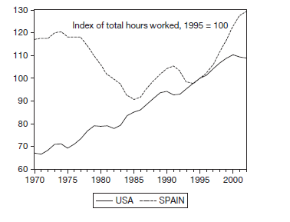
An example:
Figure 10.11 Index of Total Hours Worked in United States and Spain
It seems wise to test for a UR with intercept (Type II)

Slide 14
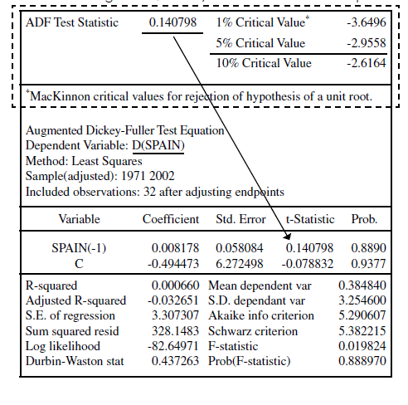

Table 10.6 Augmented Dickey-Fuller Unit Root Test on Spain
We fail to reject
the Unit Root

Slide 15
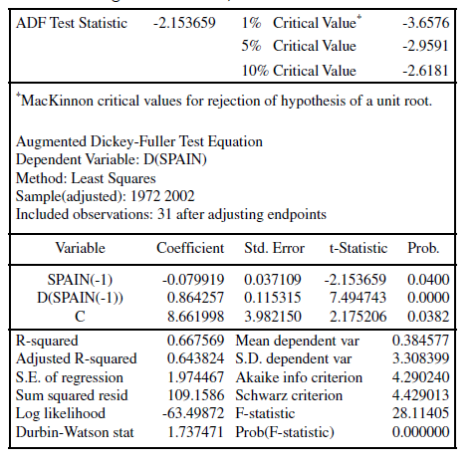
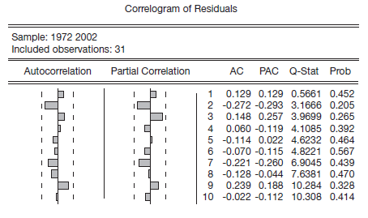
Table 10.7 Augmented Dickey-Fuller Unit Root Test on Spain
We fail to reject
the Unit Root
We can assume the residuals are white
and proceed to the estimation

Slide 16
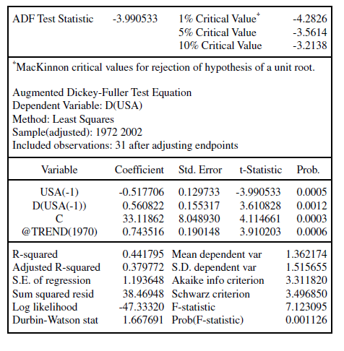
Table 10.10 Augmented Dickey-Fuller Unit Root Test on the United States

